Slide 1
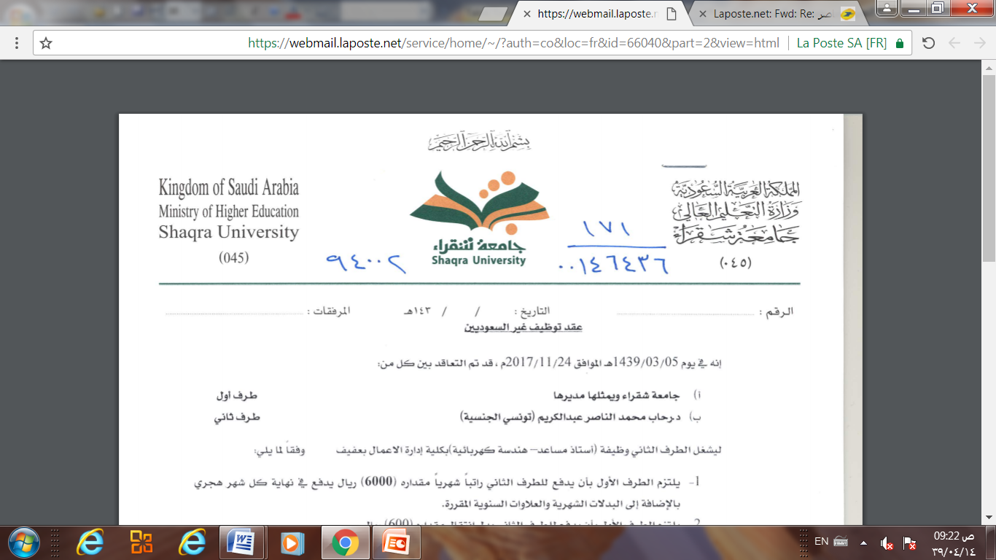
Database Management system
Lecture 7(part2)
The Enhanced Entity-Relationship
(EER) Model
Dr. Rihab Mohamed Naceur ABDELKRIM
E-mail: rihab@su.edu.sa
2017 - 2018

Slide 2
Outline
1- Subclasses, Superclasses, and Inheritance
2- Specialization and Generalization
3- Constraints and Characteristics of Specialization and Generalization Hierarchies
4- Modeling of UNION Types Using Categories
5- A Sample UNIVERSITY EER Schema, Design Choices, and Formal Definitions
6- Relational Database Design Using ER-to-Relational Mapping
7- Mapping EER Model Constructs to Relations

Slide 3
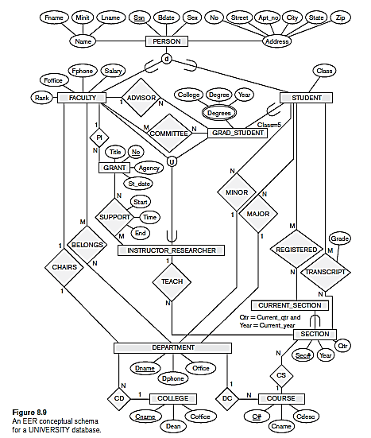
5- A Sample UNIVERSITY EER Schema, Design Choices, and Formal Definitions

Slide 4
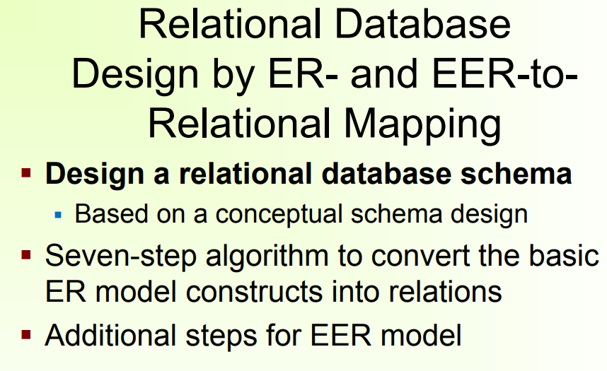
6- Relational Database Design Using ER-to-Relational
Mapping

Slide 5
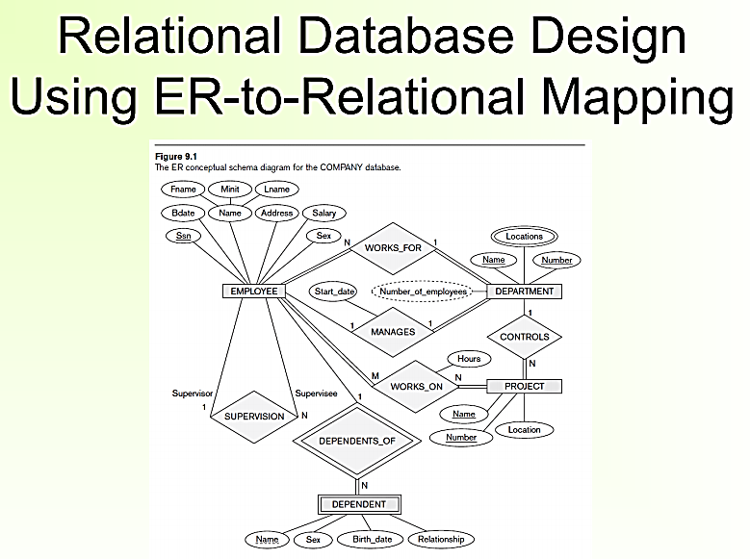

Slide 6
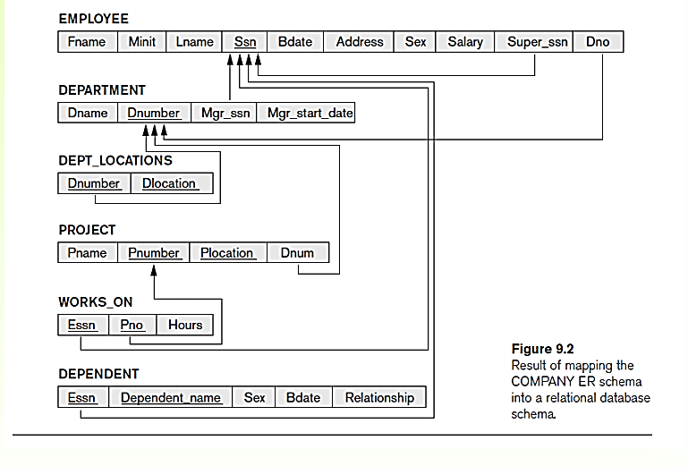

Slide 7
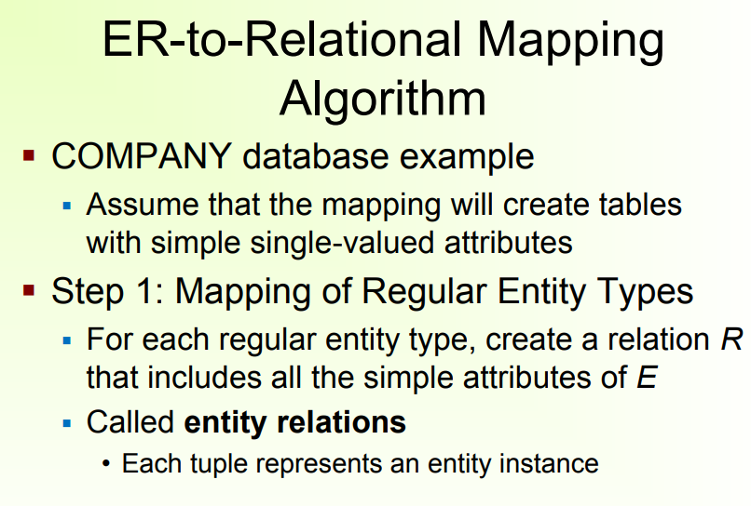

Slide 8
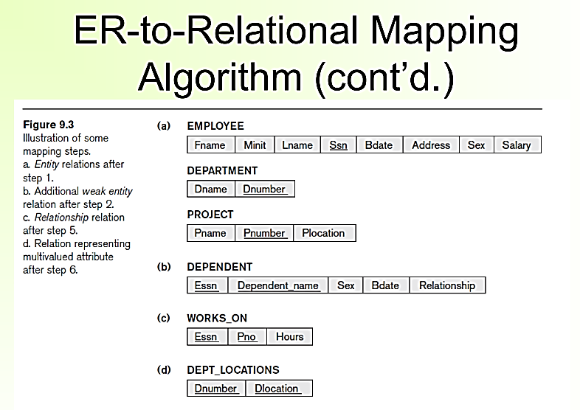

Slide 9
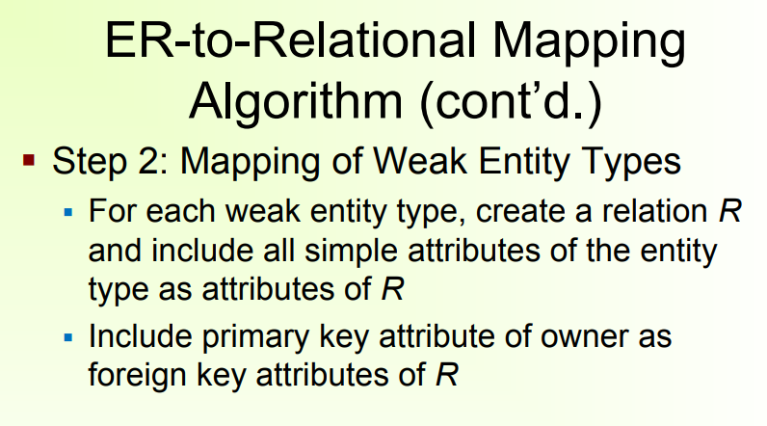

Slide 11
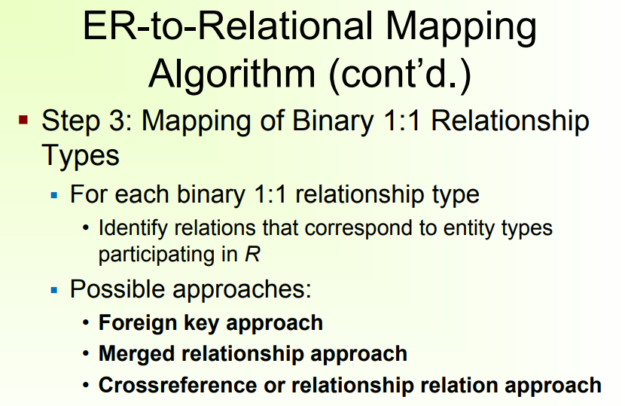

Slide 12
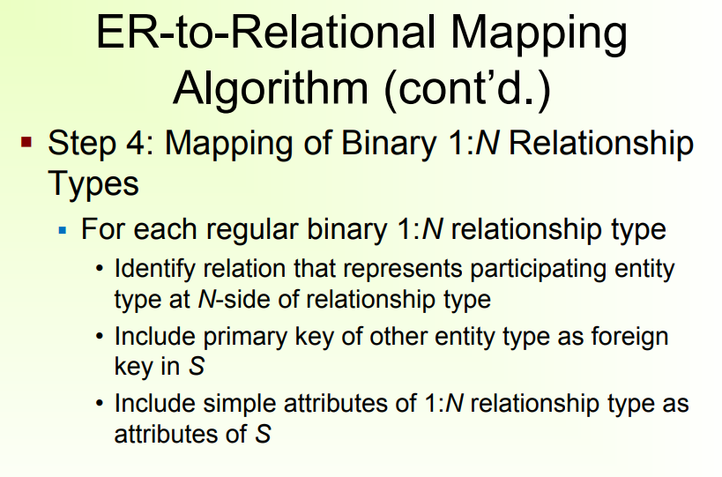

Slide 13
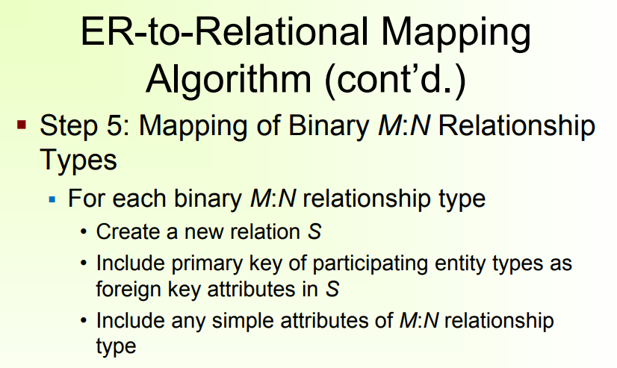

Slide 15
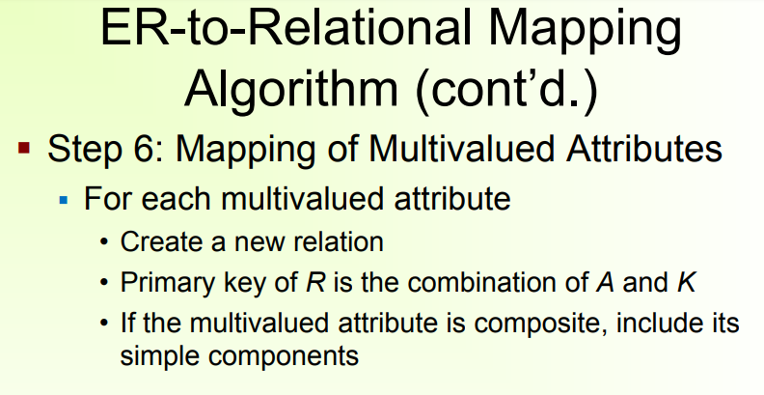

Slide 18
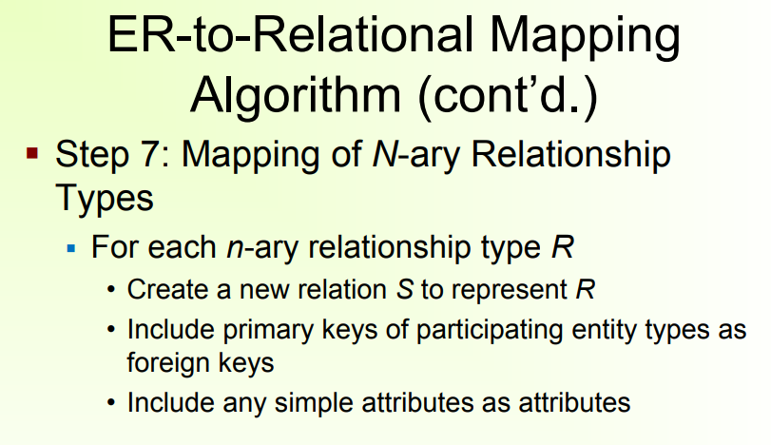

Slide 19
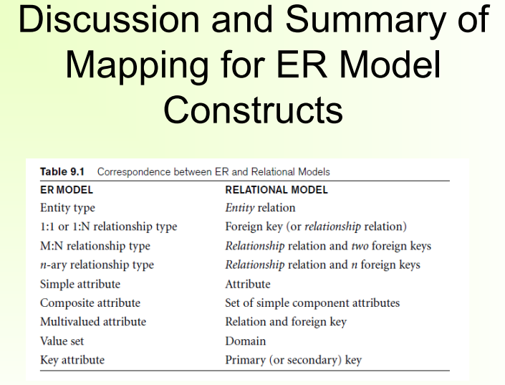

Slide 20
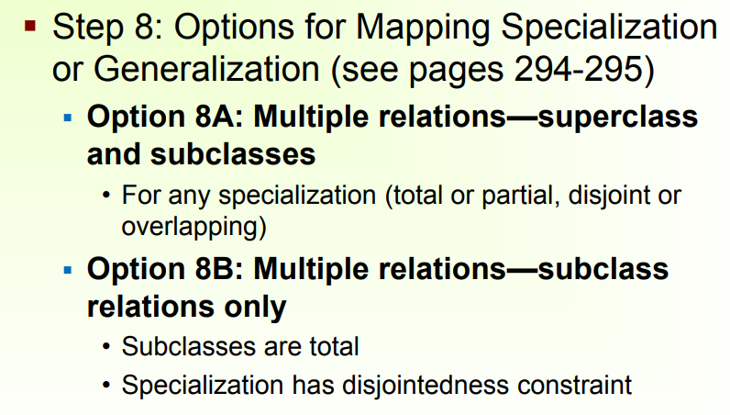
7- Mapping EER Model Constructs to Relations

Slide 21
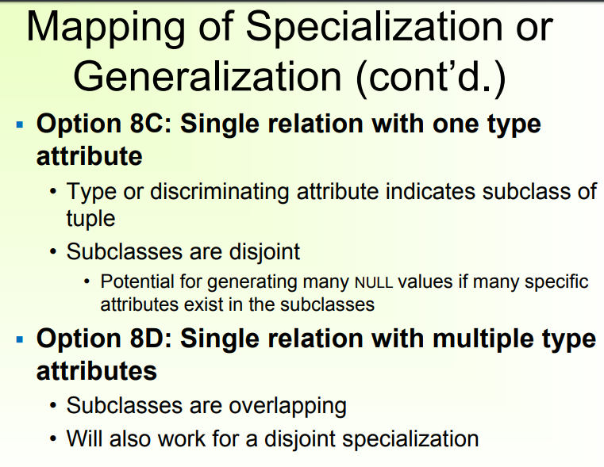

Slide 22
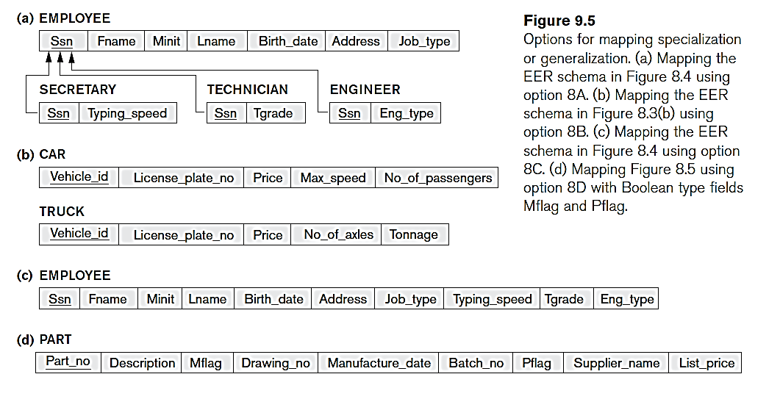

Slide 23
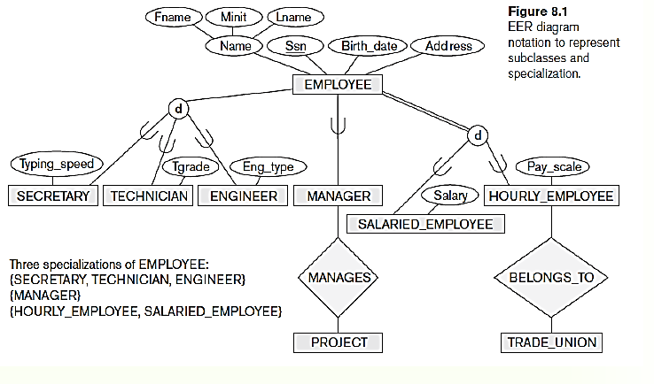

Slide 24
